Slide 1
Backpack activity
Notes:
Thank you for coming.
ACTIVITY: Have backpack weight with heavy objects labelled:
Divorce
Debt
Poor health etc

Slide 2
OUR OBJECTIVES
Today
  Commit to one change in behavior that will
  Create a simply easy to do plan for self care and long term sustainability.
  Share tools that help you ”arrive” with life as opposed to fat, tired and burned out.
Beyond the Summit
  Provide facilitator experience feedback
  Find a way to hold yourself accountable, leveraging your team
Notes:
Thank you for coming.

Slide 3
where are you with self care?
How does failure show up:
look: tired, over/under weight
sound: husband nagging
Notes:
We may have different beliefs but there are things that make all of us feel spiritually uplifted or renewed. Go to your source; yoga, cycling, Allah, God, shower. It is a silence that renews you.

Slide 4
ACTIVITY
Where do you want to be with
self care?
Notes:
INSTRUCTION: Celebrate with those who share, celebrate the goals

Slide 5
 | Where am I with this? | Where do I want to be?
Body
Knowledge
Finances
Relationships
Notes:
INSTRUCTION: Celebrate with those who share, celebrate the goals

Slide 6
5 Capitals | Hollywood | Academia | Church | Personal
1) Spiritual
2) Relational
3) Physical
4) Intellectual
5) Financial

Slide 7
1. Spiritual
What renews you? gives you energy?
Notes:
We may have different beliefs but there are things that make all of us feel spiritually uplifted or renewed. Go to your source; yoga, cycling, Allah, God, shower. It is a silence that renews you.

Slide 8
Relational Capital
Who helped put you in this position of leadership?
    -Have you neglected them?
    Parents, friends, mentors?
    -Are you nourishing them?
    Are you allowing yourself to be nourished by them?
Notes:
We may have different beliefs but there are things that make all of us feel spiritually uplifted or renewed. Go to your source; yoga, cycling, Allah, God, shower. It is a silence that renews you.

Slide 9
Physical Capital
FOOD: Sometimes your starting point is NOT eating well,
its remembering to eat.
Notes:
We may have different beliefs but there are things that make all of us feel spiritually uplifted or renewed. Go to your source; yoga, cycling, Allah, God, shower. It is a silence that renews you.

Slide 10
Make decisions that nourish and sustain you.
Notes:
We may have different beliefs but there are things that make all of us feel spiritually uplifted or renewed. Go to your source; yoga, cycling, Allah, God, shower. It is a silence that renews you.

Slide 11
Intellectual Capital
Knowledge can be a moving target
as the truth changes.
Notes:
We may have different beliefs but there are things that make all of us feel spiritually uplifted or renewed. Go to your source; yoga, cycling, Allah, God, shower. It is a silence that renews you.

Slide 12
5) Financial Capital
Is this your master?
Though rated last does it make you
sacrifice all other capital?
Notes:
We may have different beliefs but there are things that make all of us feel spiritually uplifted or renewed. Go to your source; yoga, cycling, Allah, God, shower. It is a silence that renews you.

Slide 13
ACTIVITY
Take a 2 minutes to rank how
you have prioritized these capitals in practice,
and then create what the ideal is for you.
Notes:
We may have different beliefs but there are things that make all of us feel spiritually uplifted or renewed. Go to your source; yoga, cycling, Allah, God, shower. It is a silence that renews you.

Slide 14
5 Capitals | Hollywood | Academia | Church | Personal
1) Spiritual
2) Relational
3) Physical
4) Intellectual
5) Financial

Slide 15
Corey Carlson
corey@_____.com

Slide 16
Working incessantly, sacrificing diet, family and exercise will cause you to crash, removing all gains made by your shortcut.
The hardwork is finding balance. Let us work on that.

Slide 17
Reactive
Choice
Proactive
Reactive
Rest OR Crash
Prune
Notes:
This is when you are drinking 5 redbulls

Slide 18
You Count

Slide 19
Self: The “Self” genre of programming focuses on themes of self-knowledge, self-exploration, and pathways toward individual growth and development;
Team: The “Team” genre of programming focuses on themes of team engagement, cultivation, and cohesiveness;
Organization: The “Organization” genre of programming focuses on themes of organizational management, operations, and capacity-building; .

Slide 20

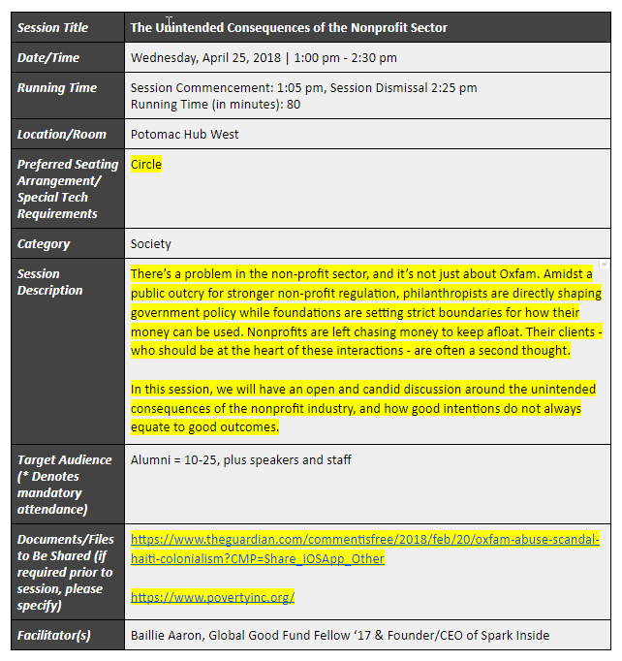
7
The Global Good Fund
OUR SESSION TEMPLATES
Be sure to:
CONFIRM date/time of session
MAKE NOTE of session duration
ADD preferred seating arrangement/special tech requirements
EDIT session description
ADD links to document files/website links/resources
SPECIFY if/which of these resources should be shared with audience members prior to summit
GET TO KNOW your room assignment

Slide 21
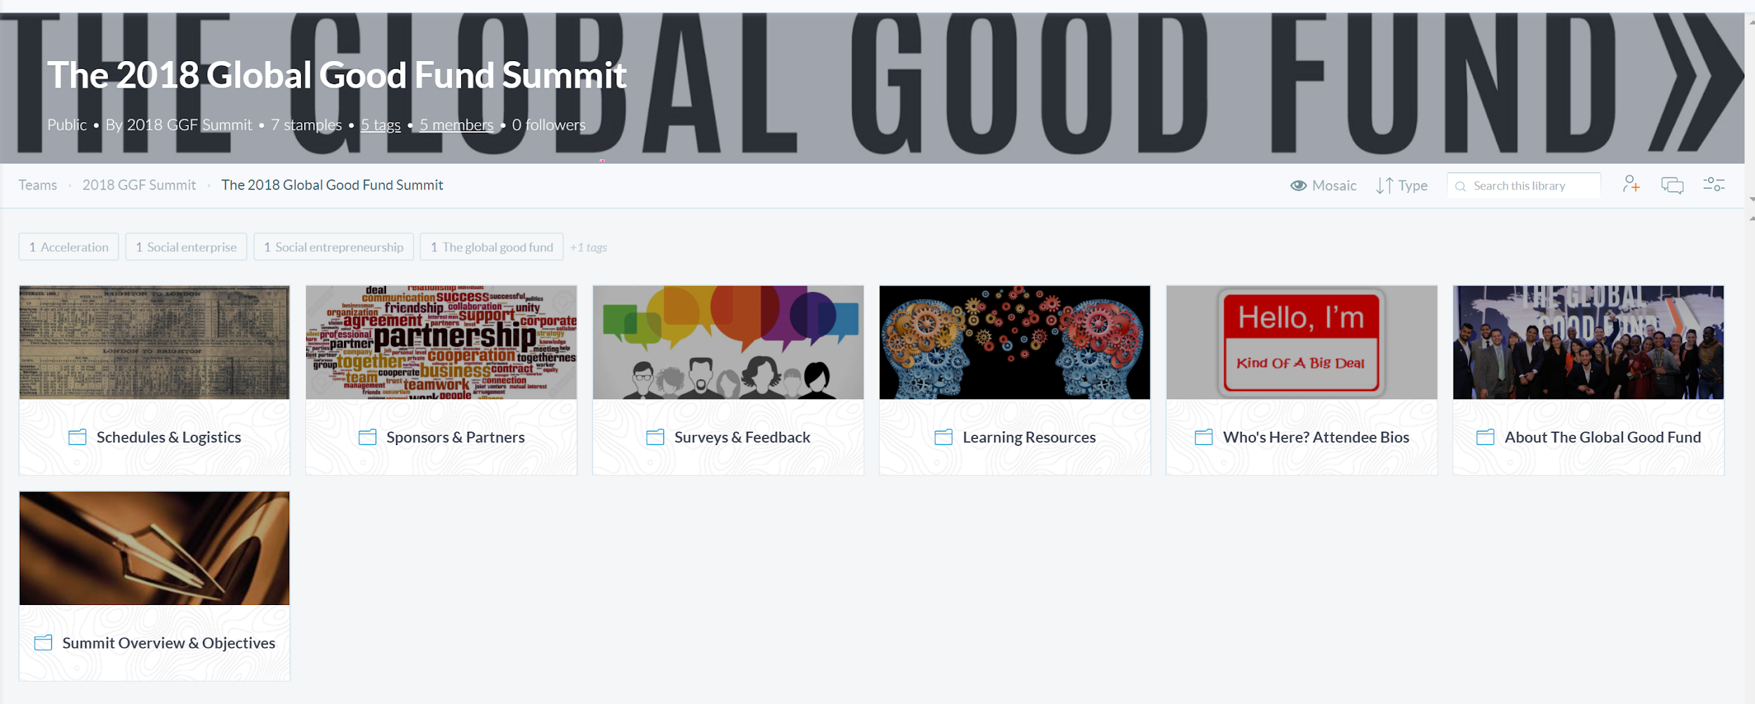
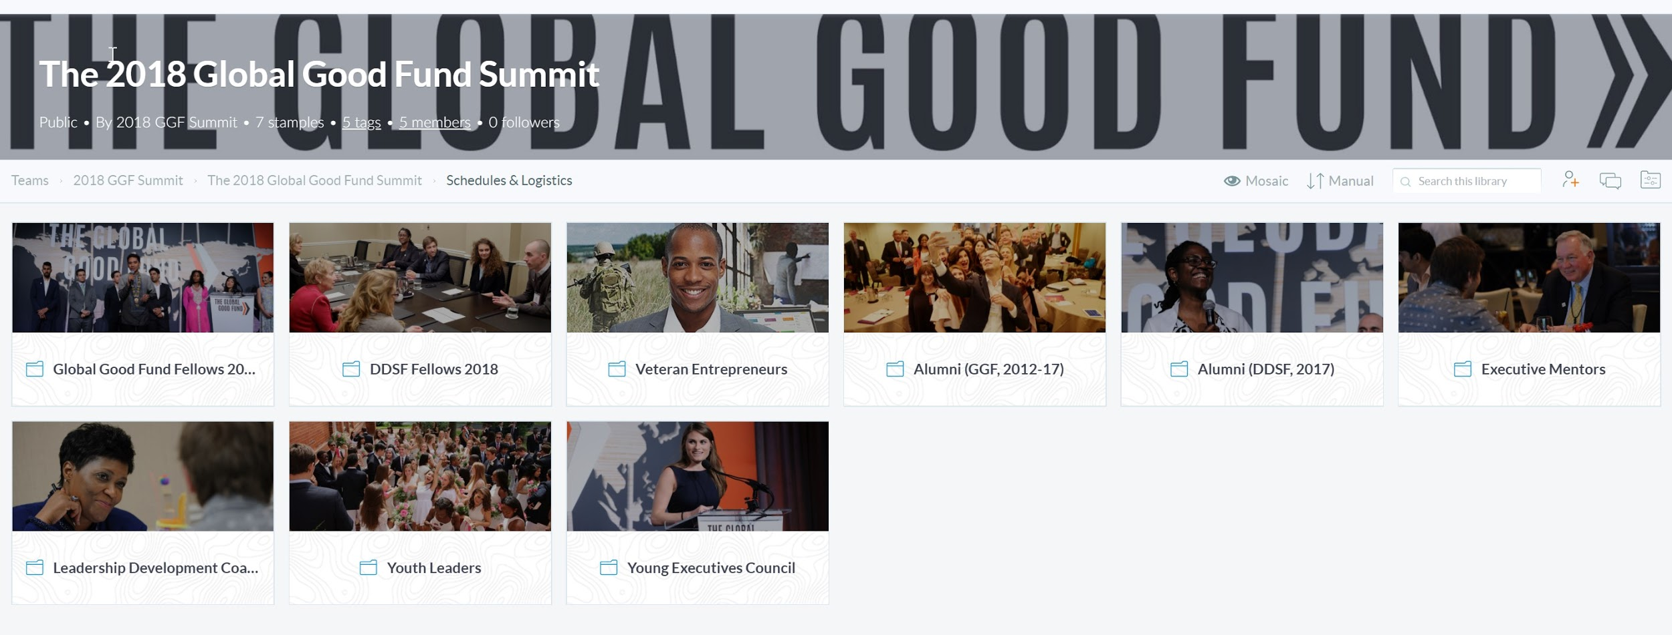
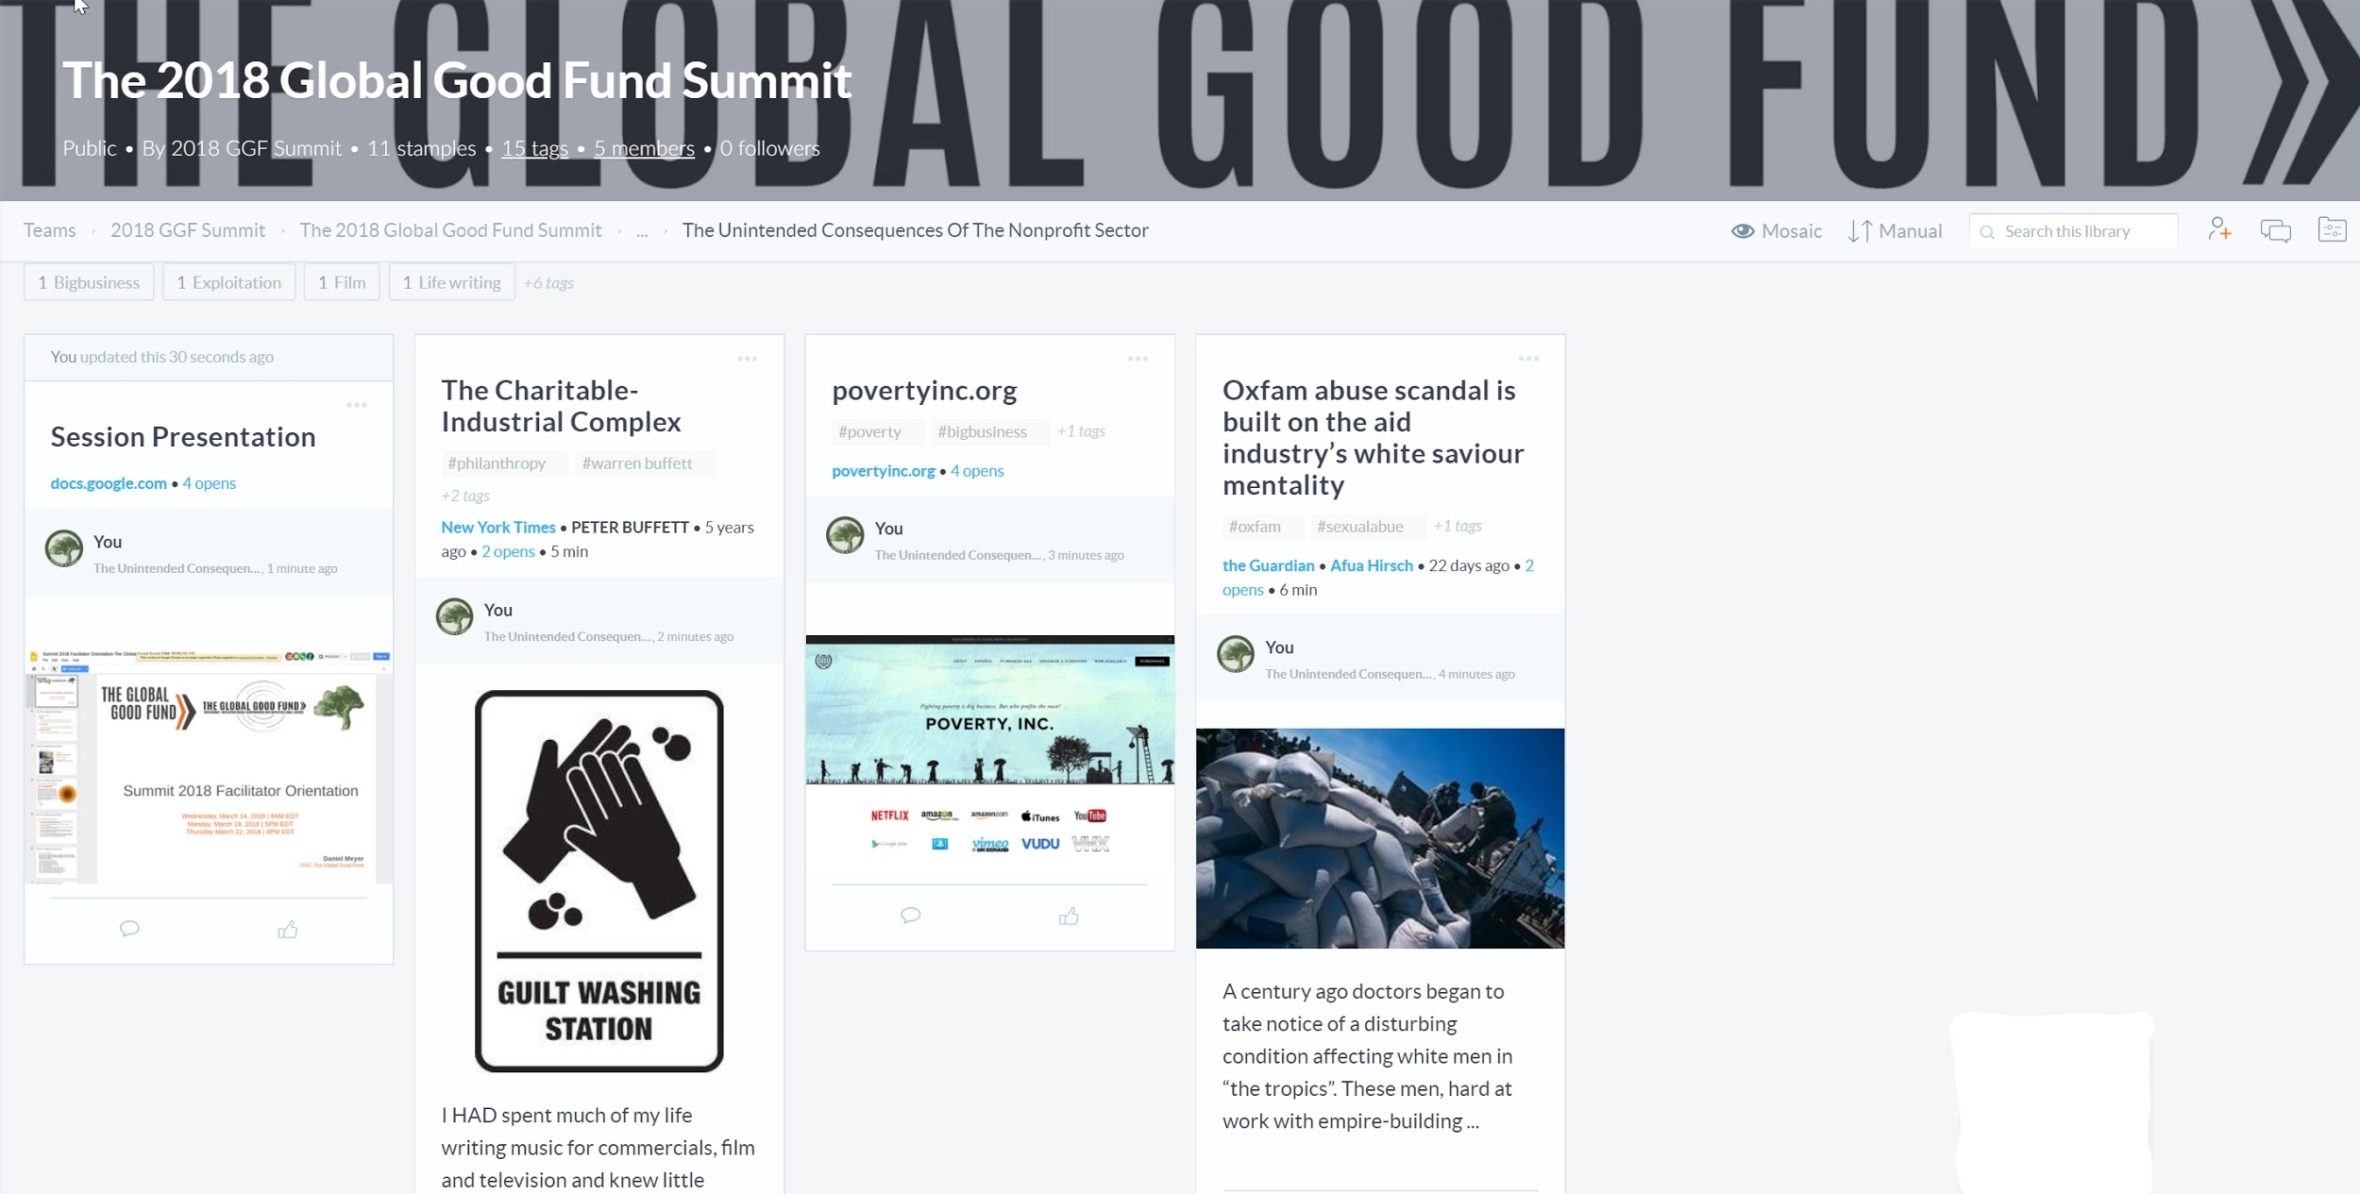
8
The Global Good Fund
OUR DIGITAL RESOURCES PORTFOLIO
All session materials, links, and resources will be housed online
Available digitally during and after Summit
Saves on paper, mitigates loss of materials
Better allows for follow-up and application with local teams after Summit

Slide 22
How do you nourish your spiritual self?
reflection
reading
yoga
praying
meditation

Slide 23
9
The Global Good Fund
OUR STRATEGIES FOR SUCCESS
Nurture engagement & involvement
Adhere to session description while personalizing
Encourage guests to share, converse, move
Prioritize impact over transmission of knowledge
Close with actionables and post-summit applications

Slide 24
The Global Good Fund
10
OUR TIMELINE
DATE | ACTION/DELIVERABLE | LEAD/SUPPORT
MARCH 22, 2018 | Attend one of three facilitator orientation meetings | DANIEL/YOU
MARCH 25, 2018 | Finalize Google Document edits/corrections | YOU/DANIEL
APRIL 13, 2018 | Submit any links, materials, or resources you would like added to digital portfolio (if not previously added to Google Doc template) | YOU/DANIEL
APRIL 20, 2018 | Submit final presentation documents for final review | YOU/DANIEL
APRIL 25-28, 2018 | Facilitate session during allotted time | YOU/GGF STAFF
MAY 4, 2018 | Provide/complete Summit ‘18 Facilitator survey/feedback | YOU/DANIEL
MAY 15, 2018 | Receive session feedback from audience members | DANIEL/YOU
KEY
*Deliverable Prior to Summit
*Deliverable During Summit
*Deliverable Post-Summit

Slide 25
11
The Global Good Fund
OUR HELPFUL LINKS
Learning Resources Folder (Stample Digital Portfolio)
Stakeholder Bios and Background (Click on “Our People”)
Tentative Summit 2018 Agenda
Your Adoring Fans:
  Daniel Meyer, Outgoing GGF COO & Under A Tree Founder/President
    daniel.meyer@globalgoodfund.org (until March 30th)
    daniel@underatree.org (post March 30th)
  Manolo Paez, Chief of Staff & Summit/Gala 2018 Coordinator
    manolo.paez@globalgoodfund.org

